Slide 1


Azure Stack Workshop
Sponsored by Mark III/HPE/MSFT
Kevin Sullivan Global Black Belt | Azure Stack
kevin.sullivan@microsoft.com

Slide 2
Agenda
8:30am – 8:45am – Registration
8:45am – 9:00am – Welcome from Mark III
9:00am – 9:30am – Overview of Azure Stack and Use Cases
9:30am – 10:15am – Lab #1: Connect to Azure Stack, Plans/Quotas/Offers/Subscriptions
10:15am – 10:30am – Break
10:30am – 11:00am – Overview of Azure Stack PaaS Services
11:00am – 12:00pm – Lab #2: Deploying a PaaS App – SQL DB, Web App, etc.
12:00pm – 1:00pm – Working Lunch (HPE & Azure Stack Product Overview)
1:00pm – 2:30pm – Lab #3: Deploying Web API and Serverless Functions
2:30pm – 3:00pm – Q&A and Close

Slide 3

Overview of Azure Stack
Notes:
Portal Comparison
Deploy VM across both Azure & Azure Stack (separately)

Slide 4


Consistency across the cloud and the edge
a
b
c
d
Microsoft Azure
Azure Sphere
Drone
Industrial
Assets
Azure Data Box Edge
Azure Stack
Azure IoT Edge
Azure Services
Azure Security Center
Azure Active Directory
Azure Management
Azure Machine Learning
Partner Ecosystem
Notes:
Get consistency across cloud and edge
Imagine, architect, and build new, distributed applications on a consistent and comprehensive platform that spans from the cloud to the edge.
Application development platform
Get consistency with your programming models, app services, data services, and DevOps to simplify your solution development and deployment.
Users can develop an event-based system with Azure Functions that runs on Azure, Azure Stack, and Azure IoT Edge.
Security
Reduce the complexity of managing security across a distributed infrastructure.
Azure Security Center provides a built-in, unified approach across environments and intelligent threat protection for workloads running on cloud-to-edge solutions.
Identity
Get identity management for cloud-to-edge solutions with Azure Active Directory.
Guard against unauthorized access to apps, devices, and data —including conditional access, access control lists, identity protection, and access reviews.
Management
Get built-in and intelligent management tools for monitoring, backup, disaster recovery, and update management to simplify the management of cloud resources in Azure as well as your edge environment
Artificial Intelligence
Build machine learning models in Azure that you can run at the edge to deliver real-time insights. Retrain and improve your current machine learning models by transferring your data sets to Azure

Slide 5
Run the Edge locally and disconnected with Azure Stack
a
b
c
d
Azure Sphere
Drone
Industrial
Assets
Azure Data Box Edge
Azure Stack
Azure IoT Edge
Azure Services
Azure Security Center
Azure Active Directory
Azure Management
Azure Machine Learning
Partner Ecosystem

Slide 6
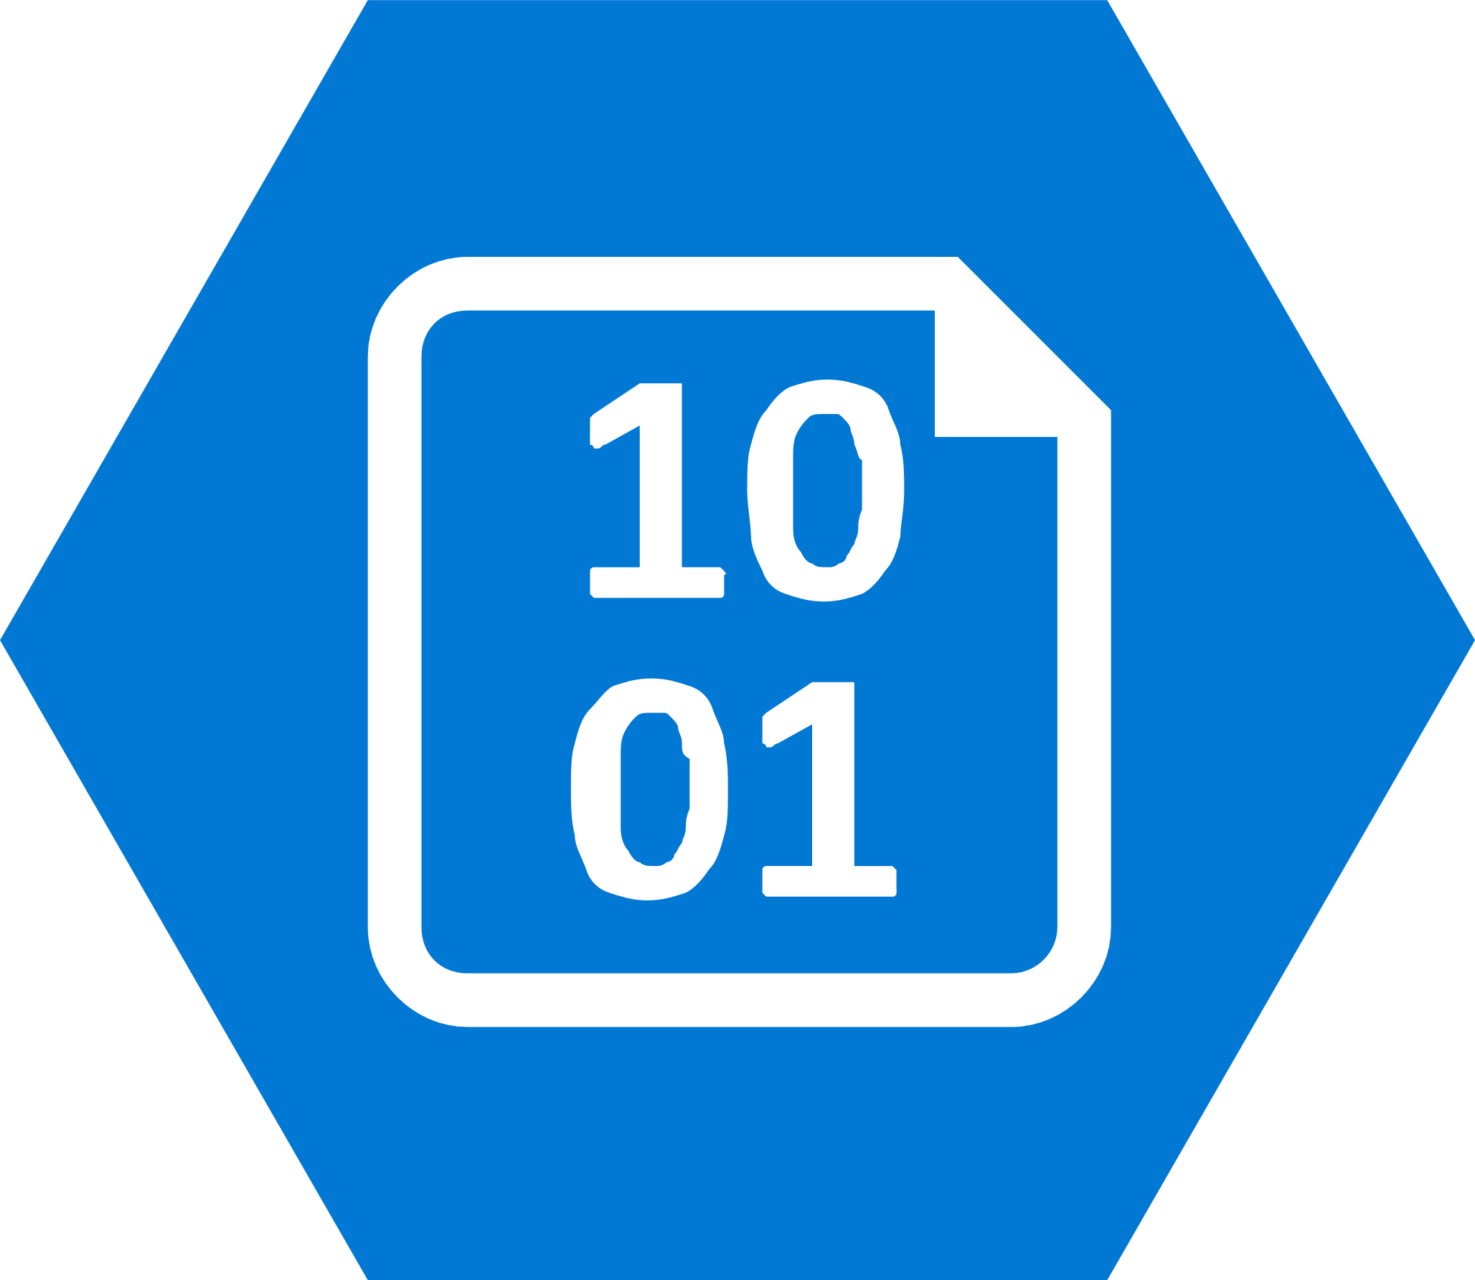




Azure Stack
Complete autonomous cloud
Only consistent hybrid cloud that can run connected or disconnected
Edge & Disconnected
Cloud application model
Common application model, tools and APIs with Azure simplifying DevOps
Regulatory & Data Sovereignty
Azure Services & Marketplace
Azure web services, containers, Azure Functions, & Azure Marketplace
Integrated System
cloud inspired infrastructure via integrated systems from major H/W partners
Application Modernization

Slide 7
Azure Stack
Azure Stack is an extension of the Azure platform
It brings the agility and innovation of cloud computing to on-premises environments
Organizations can build modern applications across hybrid cloud environments with the right flexibility and control
Consistent…
Tools and experiences
Portal | PowerShell | DevOps tools | More
Easily transfer your skills and processes between Azure clouds while using the tools you want
Cloud application model
Azure Resource Manager
Manage your cloud resources the same way everywhere
Azure Services and Marketplace
Compute | Networking | Storage |
App Service | Functions | More…
Get what you need when you need it with true cloud services on-premises
Cloud infrastructure
Integrated system design
Go faster, safely with a cloud inspired infrastructure via integrated systems

Slide 8
Azure Stack
Azure Stack is an extension of the Azure platform
It brings the agility and innovation of cloud computing to on-premises environments
Organizations can build modern applications across hybrid cloud environments with the right flexibility and control
Consistent…
Tools and experiences
Portal | PowerShell | DevOps tools | More
Easily transfer your skills and processes between Azure clouds while using the tools you want
Cloud application model
Azure Resource Manager
Manage your cloud resources the same way everywhere
Azure Services and Marketplace
Compute | Networking | Storage |
App Service | Functions | More…
Get what you need when you need it with true cloud services on-premises
Cloud infrastructure
Integrated system design
Go faster, safely with a cloud inspired infrastructure via integrated systems

Slide 9
Azure Stack: an extension of Azure
Consistent application development
Azure services
available on-premises
Purpose-built
integrated system
Notes:
3 core promises:
Consistent hybrid application development: Maximize developer productivity by empowering them to build and deploy applications the same way, whether they run on Azure or Azure Stack. Implement a common DevOps approach across hybrid cloud environments.
Azure services available on-premises: Adopt hybrid cloud computing on your terms. Meet business and technical requirements, with the flexibility to choose the right combination of cloud and on-premises deployment models for applications.
Integrated delivery experience: Focus on delivering high application service levels with integrated systems that are designed to deliver consistent Azure innovation in a predictable manner.

Slide 10
Azure Stack: an extension of Azure
Consistent application development
Azure services
available on-premises
Purpose-built
integrated system
Tools
Experiences
Deployments
Application patterns
Automations
Operations

Slide 11







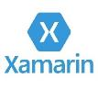


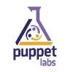
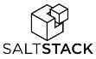









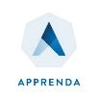







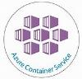


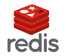




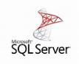








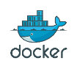
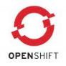
Use the open source tools you like
DevOps
Management
Applications
App frameworks
& tools
Databases &
middleware
Infrastructure

Slide 12

Hybrid pipeline with Azure and Azure Stack
Azure Public Clouds
Azure Stack Clouds

Slide 13

Hybrid cloud solutions
Data sovereignty and gravity
Hybrid DevOps
Cross cloud scaling
Geo-distributed applications
Staged data and analytics
AI at the edge

Slide 14
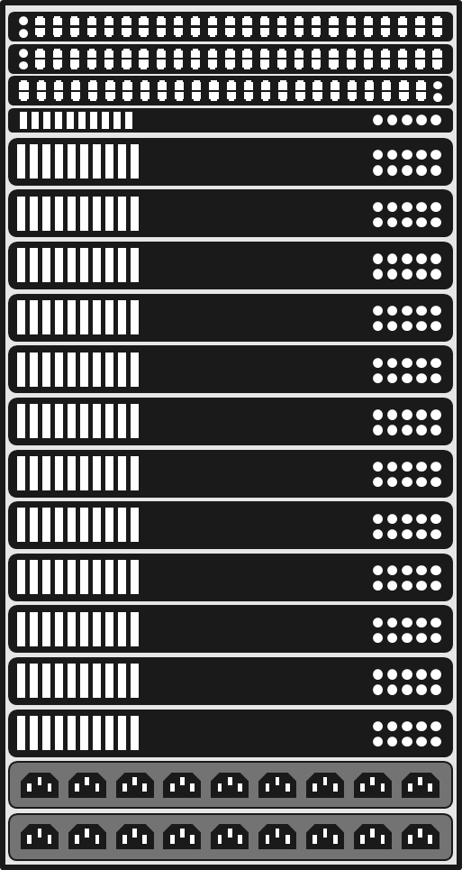
Azure Stack: an extension of Azure
Purpose-built
integrated system
Redundant, integrated 10GbE+ ToR networking
Architecture, hardware, and topology
Deployment, configuration, provisioning
Validation
Monitoring, diagnostics
4 to 16 hyperconverged compute nodes
Security and privacy
Business continuity
Patching and updates
Field replacement of parts
Redundant power

Slide 15
Lab #1: Connect to Azure Stack, Plans/Quotas/Offers/Subscriptions
https://aka.ms/markiii-stackhol

Slide 16
Important Notes about the Labs…
When asked to enter names of things such as web sites, resource groups, etc., please enter your assigned number to the name.
For example:
Lab#1 – Step 3:
Display Name: PROD-Plan-XX where XX is your assigned number
Resource Group: ContosoFinanceXX where XX is your assigned number
Lab#2a – Step1:
Database Name: ContosoFinanceWebDBXX where XX if your assigned number
Resource Group: AzureStackContosoFinanceXX where XX is your assigned number
…And so on…
In Lab #1 – Step 5:
Be sure to also include/add the Microsoft.Web service
In Lab #2b – Step 2:
You need to create the AzureStackContosoFinanceXX RG not ‘use existing’
In Lab #2b – Step 3:
The SKU available is different then depicted – just pick the one that is available!
In Lab #2 – when asked about which Type of SQL to choose, choose SQLAzure

Slide 17
Overview of Azure Stack PaaS Services
Notes:
Portal Comparison
Deploy VM across both Azure & Azure Stack (separately)

Slide 18










Azure Stack: an extension of Azure
Consistent application development
Azure services
available on-premises
Purpose-built
integrated system
Available now
Virtual Machines
IaaS-based Containers
Networking
Storage
Key Vault
Databases
Service Fabric
Azure App Service
Azure Functions
Azure Marketplace
In development
Event Hubs
IoT Hub
Kubernetes
SQL Server 2019
Blockchain Template

Slide 19

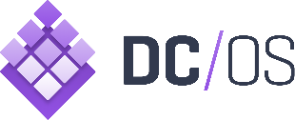











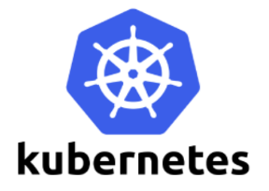


One Azure ecosystem
Work with the tools and technologies you want across Azure and Azure Stack
Goal: Applications and services that are certified for Azure work on Azure Stack
Notes:
ISVs are extending their Azure applications and services to Azure Stack, and we have a rapidly growing list of validated offerings including Bitnami, Chef, Docker, Kemp Technologies, Red Hat Enterprise Linux, and SUSE Linux. We’ve also validated popular Microsoft workloads such as Windows Server and SQL Server to run on Azure Stack.
Talking points
Pivotal and Open Source Cloud Foundry – open source PaaS platforms
Chef and Docker are VM extensions
Azure Container Service templates (DC/OS, Docker Swarm, Kubernetes)
RedHat and SUSE Linux are OS images
Linux images: SuSE, CentOS, Ubuntu, CoreOS, Debian
Networking and security virtual appliances – Load balancer and App firewall (Kemp technologies)
Validated open source stacks (e.g., Wordpress, LAMP, MySQL, MongoDB)– Bitnami
BlockChain template (Azure solution)

Slide 20
Lab #2: Deploying a PaaS App – SQL DB, Web App, etc.
https://aka.ms/markiii-stackhol
Notes:
Portal Comparison
Deploy VM across both Azure & Azure Stack (separately)

Slide 21
Important Notes about the Labs…
When asked to enter names of things such as web sites, resource groups, etc., please enter your assigned number to the name.
For example:
Lab#1 – Step 3:
Display Name: PROD-Plan-XX where XX is your assigned number
Resource Group: ContosoFinanceXX where XX is your assigned number
Lab#2a – Step1:
Database Name: ContosoFinanceWebDBXX where XX if your assigned number
Resource Group: AzureStackContosoFinanceXX where XX is your assigned number
…And so on…
In Lab #1 – Step 5:
Be sure to also include/add the Microsoft.Web service
In Lab #2b – Step 2:
You need to create the AzureStackContosoFinanceXX RG not ‘use existing’
In Lab #2b – Step 3:
The SKU available is different then depicted – just pick the one that is available!
In Lab #2 – when asked about which Type of SQL to choose, choose SQLAzure

Slide 22
Working Lunch (HPE & Azure Stack Product Overview)
Notes:
Portal Comparison
Deploy VM across both Azure & Azure Stack (separately)

Slide 23
Why HPE ProLiant for your Azure Stack platform?
Superior Flexibility
Choose the exact number of nodes for your workload so you don’t over-build and exceed budget.
Options for rack, power and network switches
Optimize processors and memory to avoid costly, unnecessary system growth
Cloud Pricing Model
Pay-as-you-consume pricing with
HPE GreenLake
Flex Capacity
Industry Leading Security
Protect, detect and recover from attacks with industry-leading encryption and firmware protection
Superior Flexibility
Choose the exact number of nodes for your workload so you don’t over-build and exceed budget.
Options for rack, power and network switches
Notes:
So, these are the top 3 reasons to partner with HPE. There are many more, but in the interests of time, we’ve covered just these three. Now, onto the next topic.

Slide 24
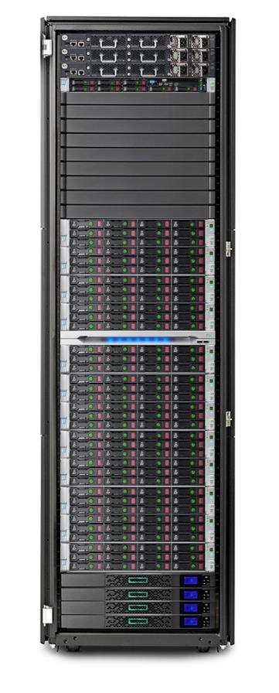
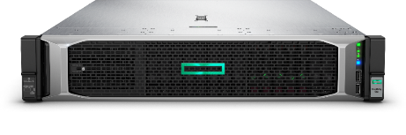
Hardware overview – Hybrid Solution
Component | Default | Options
Compute Nodes | Four HPE ProLiant DL380 Gen10 servers | 4-16 nodes
Processor¹ | Intel Skylake CPUs | 10 – 28 cores; 2.2 – 3.0 GHz
Memory² | 24 DIMM Slots; 384 GB minimum | 384 GB, 576 GB, 768 GB, 1.5 TB
Storage³ | 12 HDDs per compute node | 4TB, 6TB, 8TB, or 10TB Maximum capacity up to 120TB
 | Six SSDs per compute node (for cache) | 800GB, 1.6TB, or 3.2TB
Network | Two 25 GbE top-of-rack switches One 1 GbE RJ45 switch for out-of-band management | FlexFabric 5950 48SFP28 FlexFabric 5900 AF-48G-4XG-2QSFP+
 |  | Arista 7160 / 7020RA
 |  | Cisco Nexus 9300 / 3048 (Roadmap)
Hardware Lifecycle Host (HLH) management node | HPE ProLiant DL360 Gen10 server
Power & Environmental | 110V and 220V, HPE Power Advisor Cabinet, cables, PDU, factory build
HPE Support Services | HPE Proactive Care | 6-hour CTR, 24x7 w/4-hour onsite response, or 9x5 NBD HPE Proactive Care Advanced HPE Datacenter Care
New
1. Processors must be identical pairs
2. Memory must follow population and configuration rules
3. Storage must follow configuration rules
Notes:
Overview of standard 16 Hybrid node solution.
Solution includes server nodes, management server, and 3 TOR switches. Newest changes are faster processors with more cores – up to 28 cores at 3.0 Ghz and support for Arista Switches. Ciscso are on our roadmap for 2H 2019
HPE ProLiant for Microsoft Azure Stack provides higher storage capacity with support for up
to 120 TB of raw capacity per node—delivering a 50% overall increase in capacity, enabling
you to run workloads at a faster rate. The higher workload performance allows for a 66% boost
in memory bandwidth and double the memory capacity.

Slide 25
Hardware overview – All Flash Solution
Component | Default | Options
Compute Nodes | Four HPE ProLiant DL380 Gen10 servers | 4-8 nodes
Processor¹ | Intel Skylake CPUs | 10 – 28 cores; 2.2 – 3.0 GHz
Memory² | 24 DIMM Slots; 384 GB minimum | 384 GB, 576 GB, 768 GB, 1.5 TB
Storage³ | 12 or 16 SSDs per compute node | 800GB, 1.6TB, 3.2TB, or 6.4TB Maximum capacity up to 102TB
Network | Two 25 GbE top-of-rack switches One 1 GbE RJ45 switch for out-of-band management | FlexFabric 5950 48SFP28 FlexFabric 5900 AF-48G-4XG-2QSFP+
 |  | Arista 7160 / 7020RA
 |  | Cisco Nexus 9300 / 3048 (Roadmap)
Hardware Lifecycle Host (HLH) management node | HPE ProLiant DL360 Gen10 server
Power & Environmental | 110V and 220V, HPE Power Advisor Cabinet, cables, PDU, factory build
HPE Support Services | HPE Proactive Care | 6-hour CTR, 24x7 w/4-hour onsite response, or 9x5 NBD HPE Proactive Care Advanced HPE Datacenter Care
New
1. Processors must be identical pairs
2. Memory must follow population and configuration rules
3. Storage must follow configuration rules
Notes:
Overview of standard 8 All Flash node solution.
Solution includes server nodes, management server, and 3 TOR switches. Newest changes are faster processors with more cores – up to 28 cores at 3.0 Ghz and support for Arista Switches. Ciscso are on our roadmap for 2H 2019
HPE ProLiant for Microsoft Azure Stack provides higher storage capacity with support for up
to 102 TB of raw capacity per node—delivering a 50% overall increase in capacity, enabling
you to run workloads at a faster rate. The higher workload performance allows for a 66% boost
in memory bandwidth and double the memory capacity.

Slide 26
HPE and Microsoft Azure Stack Innovation Centers
Accelerating your move to the hybrid cloud
through hands-on collaboration with HPE and Microsoft experts
Discover how Microsoft® Azure® Stack unlocks agility and innovation
Plan and Design your apps for Azure Stack
Build and Transform your apps for hybrid cloud
Notes:
We start with helping you Discover why they Hybrid Cloud is strategic for your business – with a high level overview of what HPE Proliant for Azure Stack. From this overview you will gain a working knowledge of Azure Stack and HPE Proliant systems and how it can benefit you.
Once you understand at a high level the strategic benefits of HPE proliant for Azure Stack, we spend a day and dig into key features, learning how to build cloud applications from our experts, providing you with a deeper understanding of core features and creating a list of applications to run on Azure Stack.
Lastly you can use the resources at the center to develop and test your application with our experts and HPE ProLiant for Microsoft Azure Stack hardware and software. Try out your applications using datacenter hardware.

Slide 27
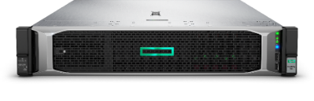
Azure Stack Innovation Centers
Experience: State-of-the-art technical engagement facility
Access to comprehensive programs from discovery, planning, designing, and producing proof-of-concept implementations
Offerings customized to your needs
Access: HPE ProLiant for Microsoft Azure Stack
Azure Stack hardware and software solutions
Azure Stack subject-matter experts from Microsoft and HPE
Locations: Multiple options
Best experience: in-person at the ASIC:
Bellevue, Geneva and Singapore
Microsoft Technology Center, customer site and remote options available
Notes:
At the innovation center we have a place for you to come and work hand and hand with experts
We have access to the latest hardware and software solutions
And we can provide these offerings at locations that meet your needs. Either in person at our facilities in Bellevue Wa, Geneva Switzerland or Singapore, at Microsoft Technology Centers worldwide or at your customer site.

Slide 28



Worldwide coverage
Azure Stack Innovation Centers:
Microsoft Technology Center in Bellevue, WA.
HPE Customer Engagement Centers in Geneva and Singapore
Microsoft Technology Centers:
Atlanta, Bangalore, Boston, Chicago, Dubai, Houston, Munich, Tokyo, and Toronto
Notes:
Map of our locations – you can see from this the joint nature of our center

Slide 29
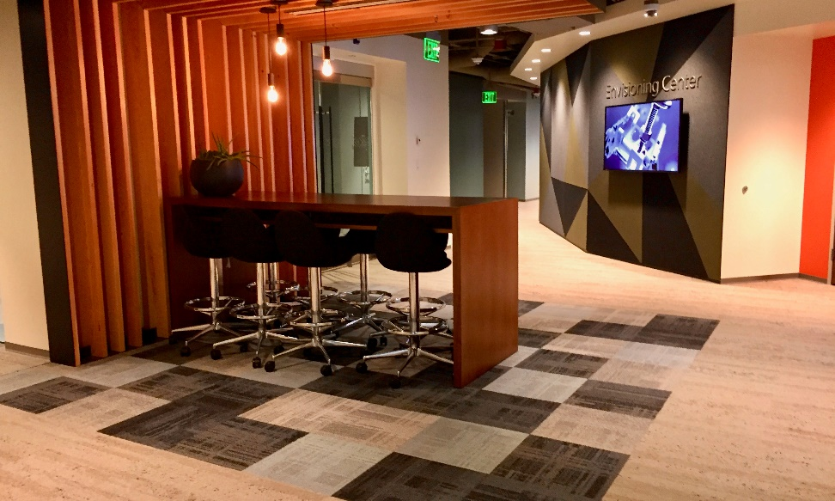

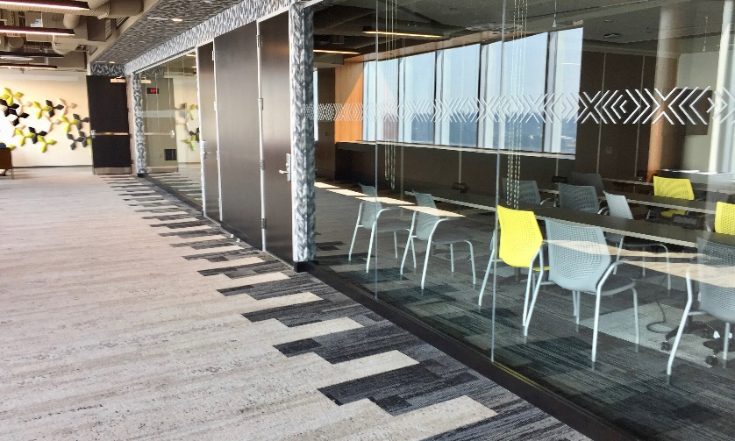
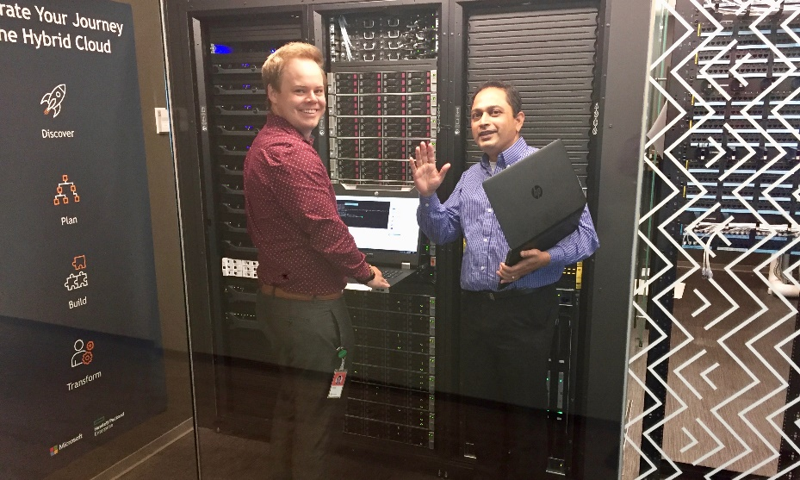
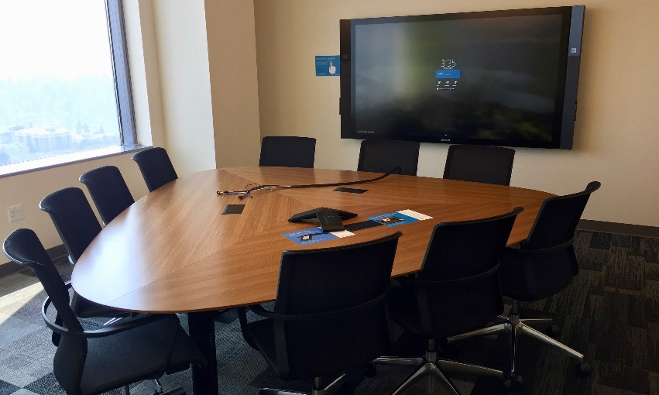
Bellevue

Slide 30


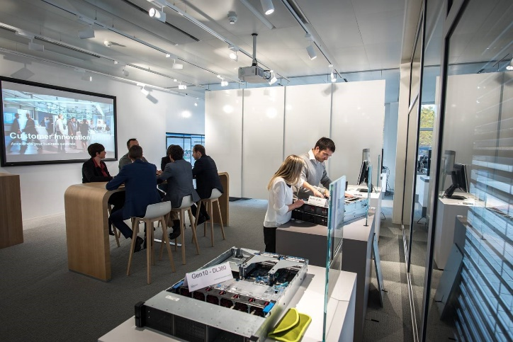
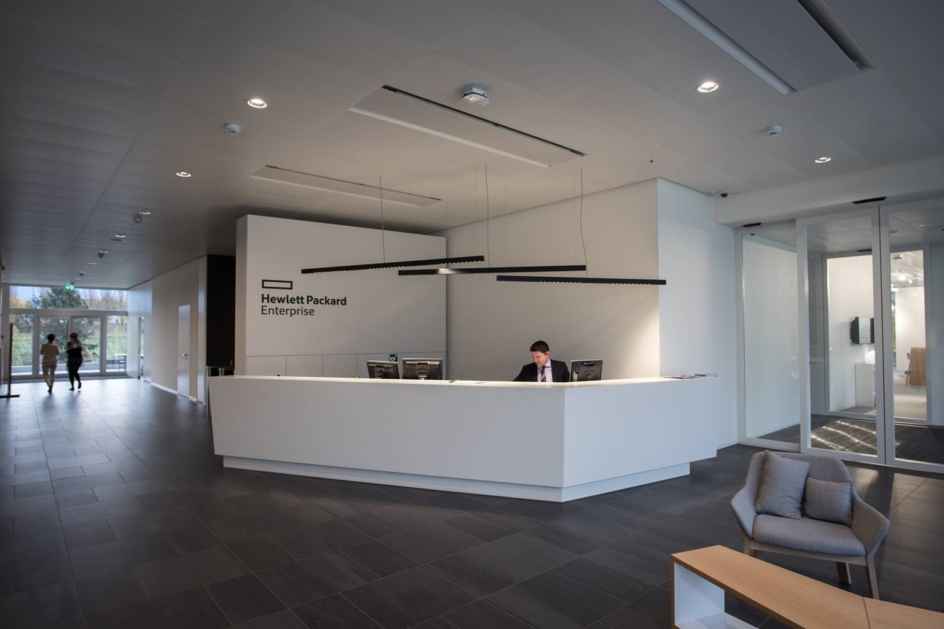
Geneva

Slide 31
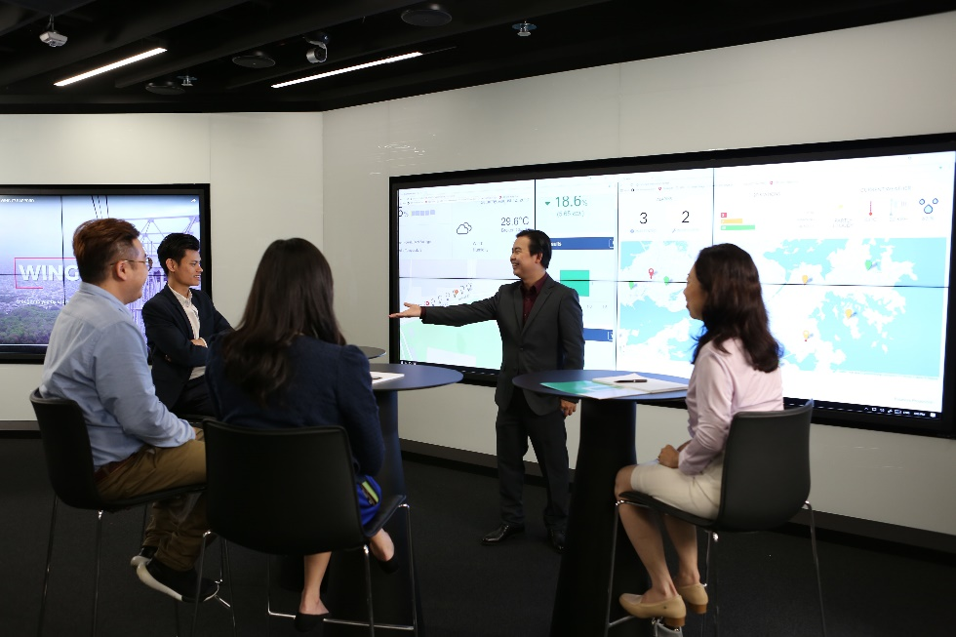



Singapore

Slide 32
ASIC offerings
Customer
commitments
Discover
Hybrid cloud strategy
Explore use cases
Azure Stack overview and demo
Plan and Design
Identify applications, develop architecture
Business application workshop
Application architecture accelerator
Build and Transform
Hands-on with Azure Stack
Guided proof of concept
Collaboration with HPE and Microsoft experts
ASIC
engagements
Resources
Self-service demo guides ISV solution demos Azure Stack instances

Slide 33
ASIC engagements
Azure Stack briefing and demo
App architecture accelerator
What is Azure Stack?
Obtain high-level understanding of Azure Stack and how it can improve business outcomes
Audience: Business and technology decision makers who have a hybrid cloud strategy
Level: 100
Duration: 1–2 hours
Location: ASIC, customer site or remotely
How do I design my apps for Azure Stack?
Develop Azure Stack architectures for key enterprise applications
Audience: Enterprise app owners, developers, technical decision makers
Level 300
Duration: 2–3 days
Location: ASIC or customer site
Business apps workshop
Guided PoC
Which of my apps are suited for Azure Stack?
Build a list of enterprise applications suited for Azure Stack
Audience: Enterprise app owners, developers, technical decision makers
Level 200
Duration: up to 1 day
Location: ASIC or customer site
Let me try it!
Get your application or its key components running on Azure Stack
Audience: Developers and owners responsible for the app being developed on Azure Stack
Level 400
Duration: up to 1 week
Location: ASIC or customer site

Slide 34

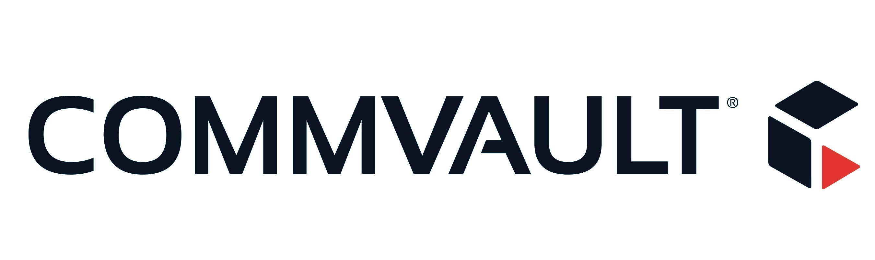


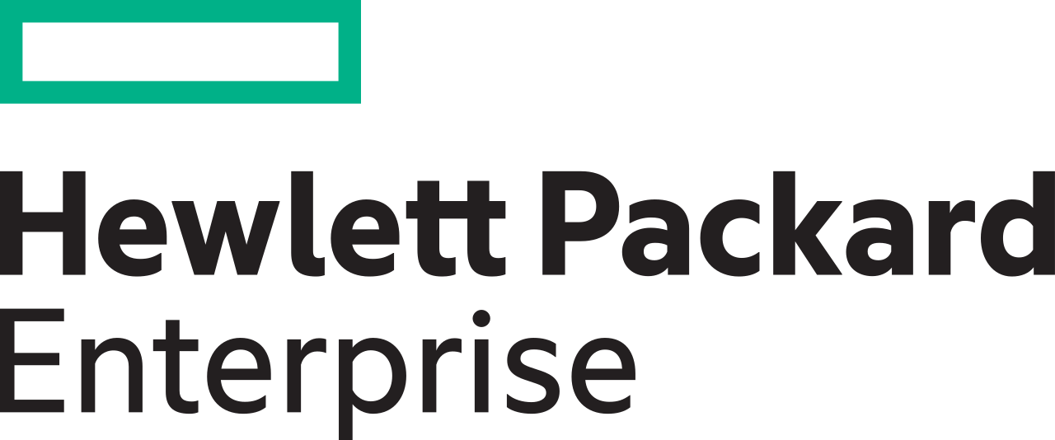
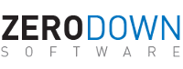
ASIC integrations and demos
BC/DR
BC/DR, Migration
Load balancing across stamps
Multi-cloud management
Monitoring with OneView Global Dashboard and Azure Log Analytics
BC/DR, Migration
More information at https://www.hpe-microsoftazurestack.com/solutions
and hpedemoportal.ext.hpe.com/search/azure%20stack

Slide 35
Getting started with the ASIC
Contact your HPE or Microsoft representative
Visit azurestackinnovationcenters.com
Send a request to asic@hpe.com or asic@microsoft.com

Slide 36
Lab #3: Deploying Web API and Serverless Functions
https://aka.ms/markiii-stackhol
Notes:
Portal Comparison
Deploy VM across both Azure & Azure Stack (separately)

Slide 37
Important Notes about the Labs…
When asked to enter names of things such as web sites, resource groups, etc., please enter your assigned number to the name.
For example:
Lab#1 – Step 3:
Display Name: PROD-Plan-XX where XX is your assigned number
Resource Group: ContosoFinanceXX where XX is your assigned number
Lab#2a – Step1:
Database Name: ContosoFinanceWebDBXX where XX if your assigned number
Resource Group: AzureStackContosoFinanceXX where XX is your assigned number
…And so on…
In Lab #1 – Step 5:
Be sure to also include/add the Microsoft.Web service
In Lab #2b – Step 2:
You need to create the AzureStackContosoFinanceXX RG not ‘use existing’
In Lab #2b – Step 3:
The SKU available is different then depicted – just pick the one that is available!
In Lab #2 – when asked about which Type of SQL to choose, choose SQLAzure

Slide 38
Q&A and Close
Notes:
Portal Comparison
Deploy VM across both Azure & Azure Stack (separately)

Slide 39
Azure Stack Purchasing

Slide 40
How to buy
Azure Stack is sold as an integrated system, with software pre-installed on validated hardware. There are two ways to buy Azure Stack:
A system you manage
Typically on-premises
You control management & operations
Buy Azure Stack hardware from OEM
Buy Azure Stack services from Microsoft
Call Microsoft for support
A managed service
Typically at service provider premises
Service is managed for you
Buy service from a service provider
Service is inclusive of hardware and software
Call service provider for support

Slide 41
How to buy
Azure Stack services can be purchased in 2 ways: a pay-as-you-use model, or a capacity model.
Pay-as-you-use
Azure Virtual Machines
Base VM | $0.008/vCPU/hour ($6 vCPU/month)
Windows Server VM* | $0.046/vCPU/hour ($34 vCPU/month)
Azure Storage
Blob Storage | $0.006/GB/month (no transaction fee)
Table and Queue Storage | $0.018/GB/month (no transaction fee)
Standard Unmanaged Disks | $0.011/GB/month (no transaction fee)
Azure App Service
Web Apps, API Apps, Functions | $0.056/vCPU/hour ($41 vCPU/month)
No upfront fees – fees only for consumption
Use the same subscriptions, monetary commitments, and billing tools as Azure
Prices typically lower than Azure
Available through EA & CSP
*Windows and SQL Server virtual machines can be deployed using your existing Windows Server and SQL Server licenses in conjunction with Azure Stack

Slide 42
How to buy
Azure Stack services can be purchased in 2 ways: a pay-as-you-use model, or a capacity model.
Capacity
IaaS Package (Compute, Storage, Network, Key Vault)
$144 per physical core, per year
App Service Package (IaaS + App Services)
$400 per physical core, per year
Fixed fee, predictable cost
Annual subscription
Required for a disconnected Azure Stack
No telemetry sent to Azure
Sold as an Azure Plan SKU via normal volume licensing channels
Available on EA only
Example:
1 Scale Unit with 10 physical nodes
Each physical node has 2 sockets w/ 20 cores each
Total = 400 cores
400 x $144 = $57,600 per year for IaaS only
400 x $400 = $160,000 per year for App Services & IaaS
With the capacity model, you use your existing on-premises licenses to deploy Windows Server and SQL Server virtual machines

Slide 43
Azure Stack Roadmap & Summary

Slide 44
In Development | Azure Stack
Kubernetes on Azure Stack
IoT Hub
Event Hub
SQL Server 2019
Consistent Blockchain template
N Series VMs (GPU)
Azure capabilities on Azure Stack
Azure Stack infrastructure capabilities
Now available | Azure Stack
Service Fabric on Windows Server and Linux
Support for Containers on Windows Server and Linux
Azure Storage API version 2017-04-17
Av2 and F VM size families in Azure Stack
Support for templated Service Fabric cluster deployments
Managed Disks in Azure Stack
Azure Monitor
Expanded support for VPN Gateway interoperability
Roadmap

Slide 45
In Development | Azure Stack Infrastructure
Azure Stack integrated systems support for multiple scale units
Azure Stack security - Drift Detection
Display VM prices in Azure Stack portal
Support for Azure Stack behind a proxy
Azure capabilities on Azure Stack
Now available | Azure Stack Infrastructure
Azure Stack support for Azure Site Recovery
Compliance certification guidance
Azure Government Cloud Integration for Azure Stack*
Azure Stack infrastructure backup and cloud recovery
Fed Ramp HIGH support
Ability to incrementally add capacity to Azure Stack
Azure Stack integrated systems with 16 node scale units
Integration with external Security information & event mgmt. (SIEM)
Azure Stack infrastructure capabilities
Roadmap

Slide 46
Understanding Azure Stack
Azure Stack is…
Azure Stack isn’t…
First consistent Hybrid Cloud Platform
A pure virtualization-replacement play
Integrated system with IaaS and PaaS
DIY infrastructure
Regularly updated for Azure-consistency
A static system you deploy and forget
Truly open and flexible (just like Azure)
For running .NET/Windows only
Notes:
Use these points to reinforce what Azure Stack is about.

Slide 47
Get going with Azure Stack
1
2
3
Develop
applications in Azure
Validate
Download Azure Stack Development Kit
Deploy
Order Azure Stack integrated systems for production deployment
Start your journey to be a certified Azure Stack operator today
Notes:
Azure Stack integrated systems, delivered by our HW hardware partners, are the supported production clouds that customers can purchase in order to modernize their application portfolio across cloud and on-premises environments.
The Azure Stack Development Kit (ASDK) uses the same code as an Azure Stack Integrated system, on a single physical server, so you can prototype hybrid applications in Azure and validate in Azure Stack when creating applications that are consistent across Azure Clouds Name not final

Slide 48
Thank you.
© Copyright Microsoft Corporation. All rights reserved.

Slide 49
Azure Stack Scale Unit
Redundant Top of Rack (ToR) Switches
10 GbE or better for server connectivity
Support for BGP, DCB, PFC, ETS, and Multi-Chassis Link Aggregation
BMC/Mgmt Switch
1 GbE for L3 routing and simultaneous connectivity to the ToRs
Hardware Lifecycle Host (HLH)
A server connected to BMC Network that is external to the Azure Stack environment
Hardware monitoring software
Firmware configuration and update software
Emergency management and hardware troubleshooting
Running the Azure Stack Deployment Virtual Machine for the duration of initial deployment
Redundant Power Supply Configuration
# of PDUs depends on # of Compute Nodes

Slide 50
Azure Stack Scale Unit
Azure Stack Hyperconverged Compute Nodes
Nodes: 4 servers (Minimum) to 12 (Maximum) per Scale Unit
CPU: 20 Cores | 2 socket @ 10 cores each (Minimum)
Memory: 256 GB (Minimum)
Network: 2 x 10GbE or Higher
Storage | Local OS: 400GB or Larger (Optional Mirroring)
Storage: 2+ Flash (NVMe, SSD) and 4+ Capacity (HDD)
All servers within a Scale Unit must have same configuration

Slide 51
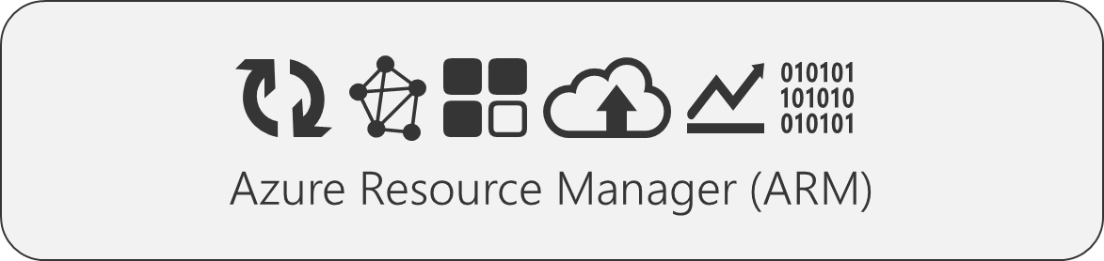
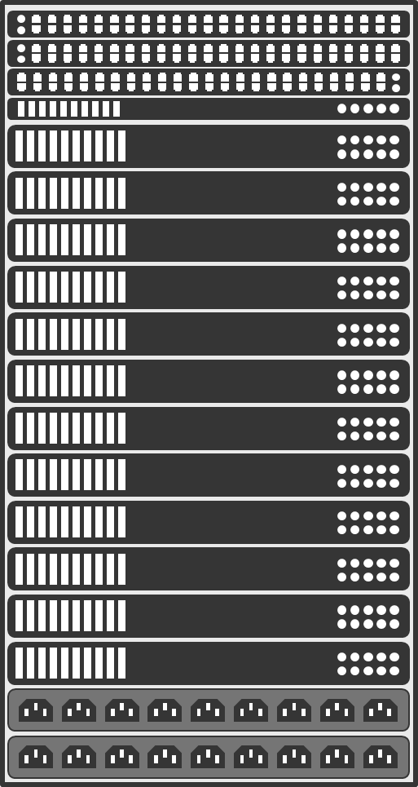
Azure Stack Scale (Today)
Single instance of Azure Resource Manager - deploy and manage the infrastructure for your solutions portal.seattle.contoso.com | adminportal.seattle.contoso.com *.seattle.contoso.com
Seattle
Single Region - logical entities comprised of the hardware resources that make up the Azure Stack infrastructure
Single Scale Unit – Unit of capacity expansion

Slide 52
Azure Stack Scale (Near Term)
Single instance of Azure Resource Manager - deploy and manage the infrastructure for your solutions portal.seattle.contoso.com | adminportal.seattle.contoso.com *.seattle.contoso.com
Seattle
Single Region - logical entities comprised of the hardware resources that make up the Azure Stack infrastructure
Multiple Scale Units – Unit of capacity expansion 2nd scale unit adds capacity, doesn’t run infra roles/services

Slide 53
Azure Stack Scale (Longer Term)
Single instance of Azure Resource Manager - deploy and manage the infrastructure for your solutions Multiple regions under management
Multiple Regions - logical entities comprised of the hardware resources that make up the Azure Stack infrastructure
Seattle
New York
Multiple Scale Units – Unit of capacity expansion 2nd scale unit adds capacity, doesn’t run infra roles/services

